Slide 1






Kindergarten
Open House
Notes:
Registration Table Set Up - Materials Needed:
2 containers for the feelings jars (one for adult feelings and one for student feelings)
Blue, red, yellow, green unifix cubes to represent Zone of Regulation
Zones of Regulation color descriptions (attached to email)
Sign-in sheet (attached to email)
Kindergarten Readiness Document (attached to email)
Copies of 25-26 Balanced Calendar (district website)
Evaluation QR Code (Email Norma Velasquez @ N.VelasquezBryant@washoeschools.net)
Feelings Jar Activity
As families check-in at the registration table, please ask them how they are feeling about their child’s transition into Kindergarten. Next, ask the child how they are feeling about getting ready to start Kindergarten. Using the Zones of Regulation template as a guide, parents will choose a unifix cube to match how they are feeling. They will place the cube into one of the buckets. Repeat the activity for the student, but they will place their unifix cube into a separate bucket. You will use this information as part of the welcoming activity.

Slide 2




Let’s
Connect!
Contact Us
Cindy Cook, Administrative Assistant clcook@washoeschools.net
Jonna AuCoin, Principal jaucoin@washoeschools.net
Kristy Pearson, Dean of Students kpearson@washoeschools.net
10600 Green Pasture Drive. Reno, NV 89521
775-851-5444
is…
Notes:
Acknowledge the feelings in the room based on the feelings jar results. Are there and differences between family feelings vs. student feelings?
Possible questions for families to discuss with each other:
What are your hopes and dreams for your child’s kindergarten experience?
Are there specific areas where you’d like to see growth (i.e. social/emotional, academic, etc.)?
Do you have any concerns about your child starting Kindergarten?
What are some ways we can work together to ease this transition?

Slide 3
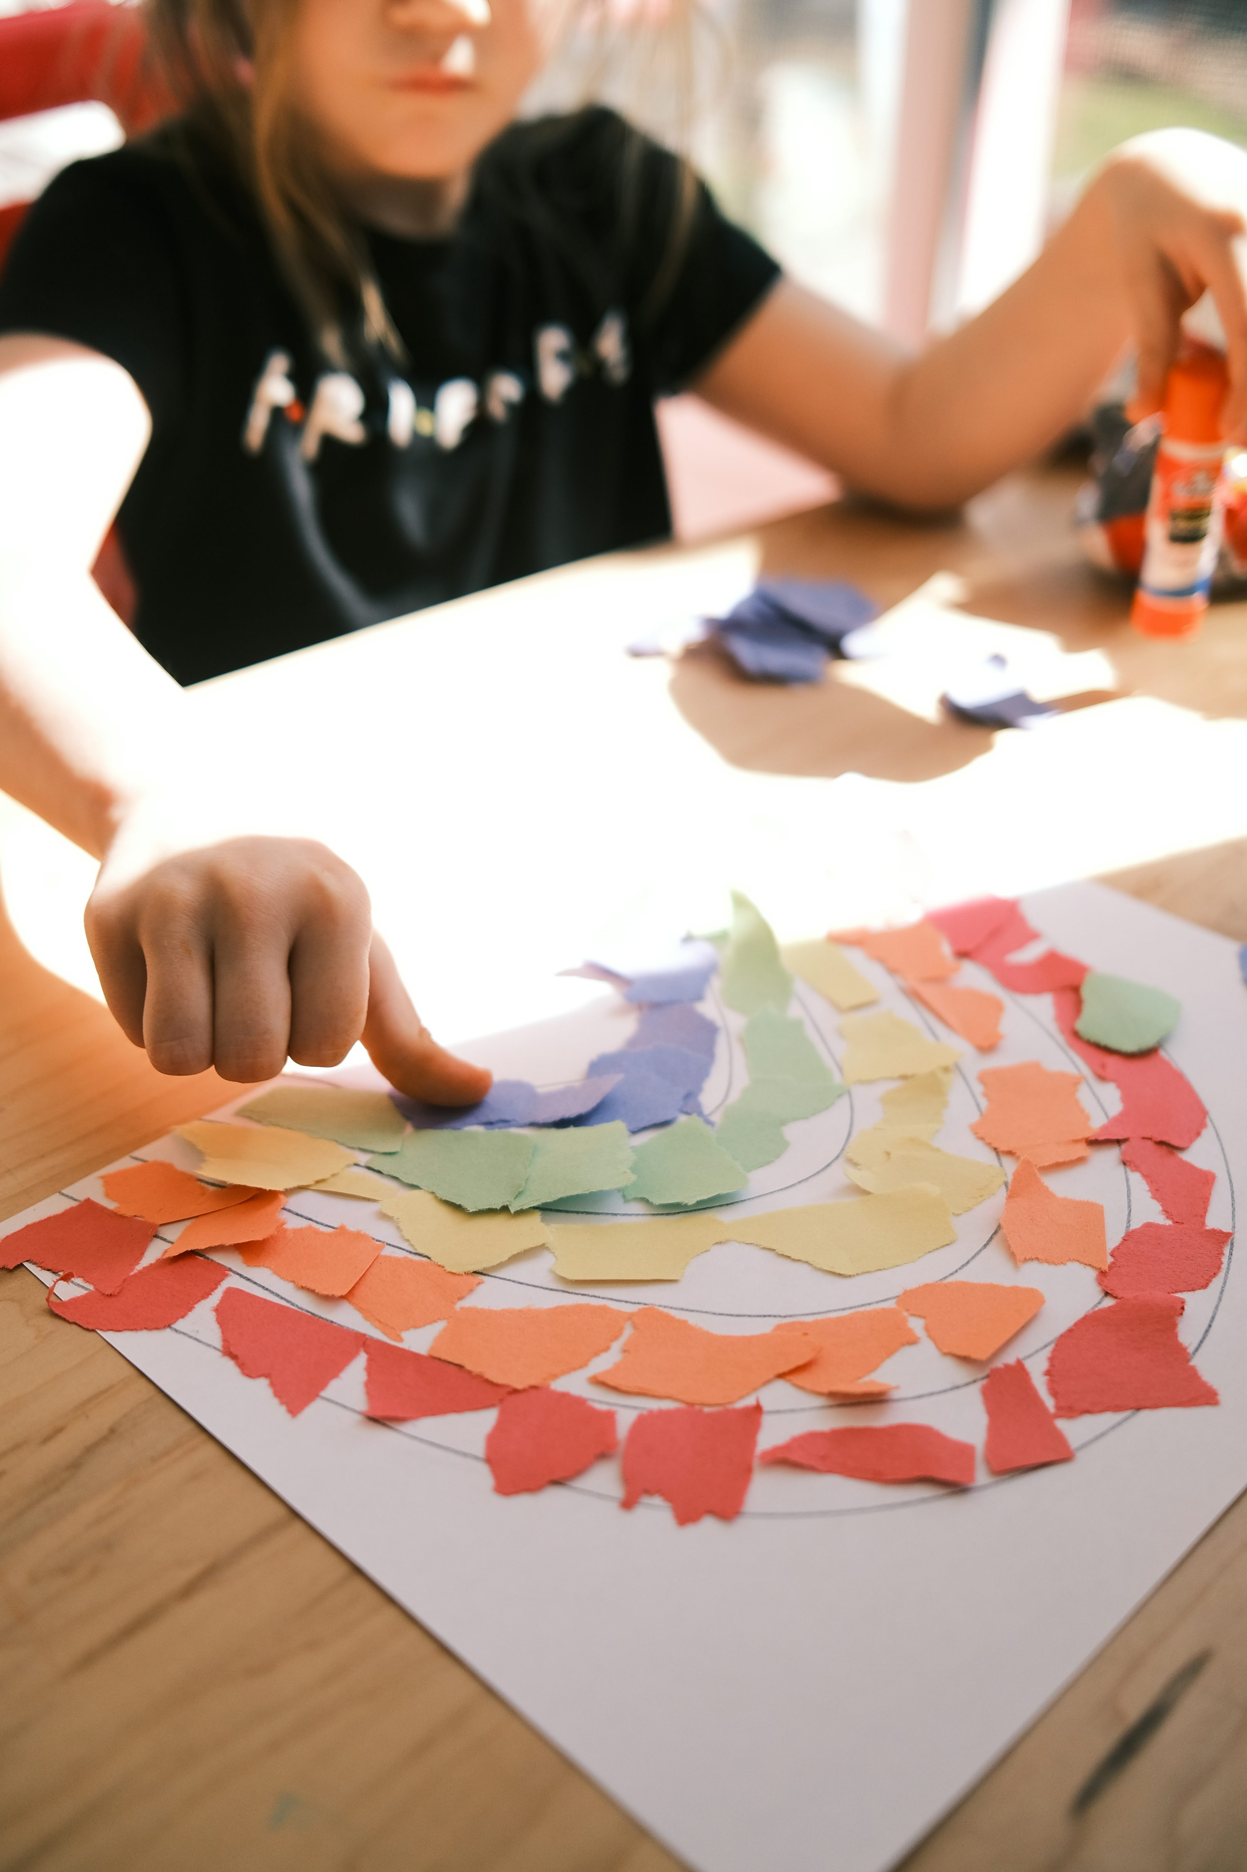
Our Mission
WCSD Promise
We will know every student by NAME, STRENGTH, and NEED so they graduate prepared for the future they choose, and we will deliver on this promise in partnership with our FAMILIES and COMMUNITY.
Notes:
Include your site-specific information for mission/vision statements

Slide 4

JWood Raw
School Culture
MISSION: To ensure everyone can learn, achieve, and succeed together.
VISION: Our vision at JWood Raw is a community where every student and staff member feels valued and empowered, embracing challenges with perseverence, and determination. Through fostering empathy, integrity and respect, we aim to develop compassionate leaders who contribute positively to society. Our safe and supportive environment nurtures collaboration and encourages critical thinking, preparing our jags to succeed in a diverse and interconnected world.
JWood Raw Motto: BETTER TOGETHER​
​
SEL Mantra: PRIDE​
PERSEVERENCE, RESPECT, INTEGRITY, DETERMINATION, EMPATHY

Slide 5


•April 8- from 3:30-5:00 PM-Kindergarten Round-up at JWood Raw Elementary
•August 11 -15 – Kindergarten Screening
•August 18- First day of Kindergarten class
•October 6-10 - Fall Break
•October 24, 27-30 - Conference Week
Important Dates
(Balanced Calendar)
Important Dates
(Balanced Calendar)
Notes:
By this time, you should have received a day/time for your child’s Kindergarten Screening. This appointment will be sometime during the week of Aug. 11-15. This is a time for the family and child to meet the teacher and see the school, and for the teacher to meet the family and child. The teacher will be working with your child during this time to begin their Kindergarten Portfolio and to understand their strengths coming into school. Among many things, your child will be counting, writing his/her name, naming letters/shapes, etc. These are the things that your child will need to know at the END of kindergarten, so don’t worry if they don’t know them yet. This information gives the teacher a starting point to know where you child is performing and to track their progress throughout the year.
After your child’s screening appointment, they will start kindergarten with their class for the first day on Aug. 18.
Conference week will be Oct. 24, 27-30. Check with your child’s school for school release time that week and conference schedules.
WCSD is on a balanced calendar. This means that the summer has been shortened and traditional breaks have been lengthened. There is one week off in October for Fall break, two weeks for Winter break, and two weeks on Spring break. These breaks, as well as holidays observed, can be found on your copy of the balanced calendar (hand them out). These dates are important to know so you can arrange child care accordingly on breaks.

Slide 6

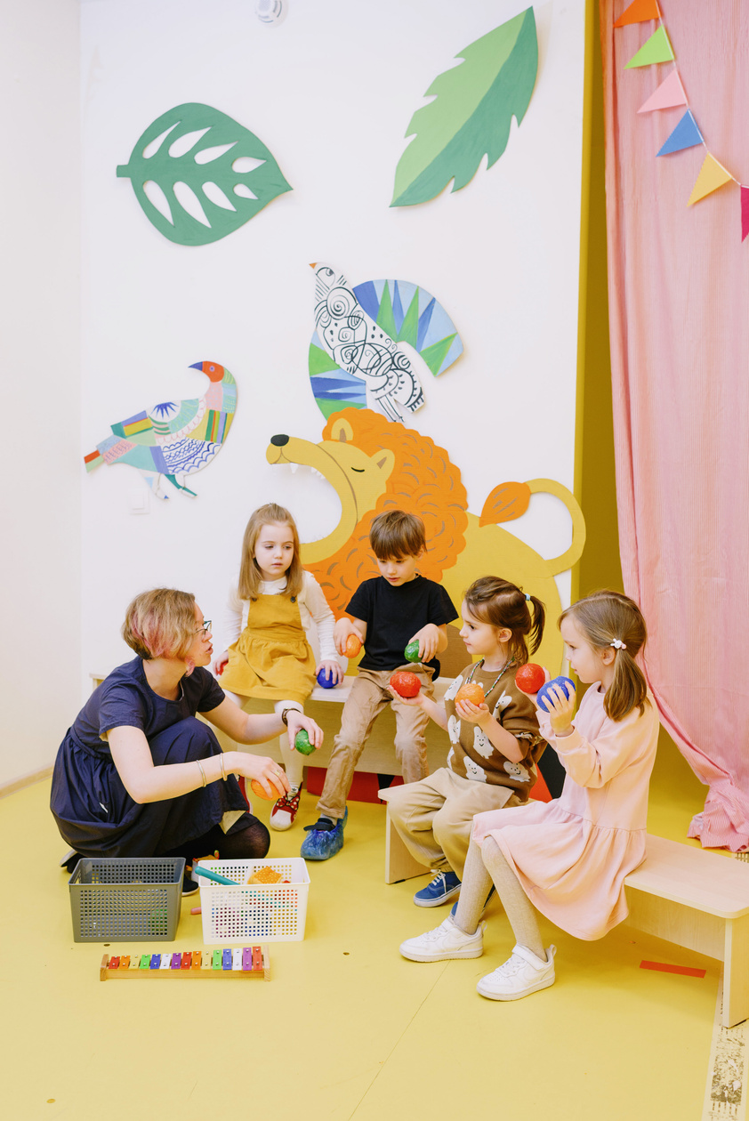

We believe that making the commitment to show up, is the most important contribution to student success.
Attendance Policy
Please call the front office at your child’s school whenever they are going to be absent.
Notes:
Kindergarten students follow the same attendance policy as all other students. Calls and/or notes in advance are always appreciated. Any absence must have a note or call to the school recorded.

Slide 7


Attendance Works:
Bringing Attendance Home
Notes:
Resources:
WCSD Family Guide to Attendance Flyer –
https://www.washoeschools.net/cms/lib/NV01912265/Centricity/domain/705/attendance_resources/family_resources/WCSD%20Guide%20to%20Attendance%2024-25.pdf
Video linked in the slide: https://www.attendanceworks.org/resources/videos/
SPANISH Attendance Works Video: https://vimeo.com/130556839

Slide 8


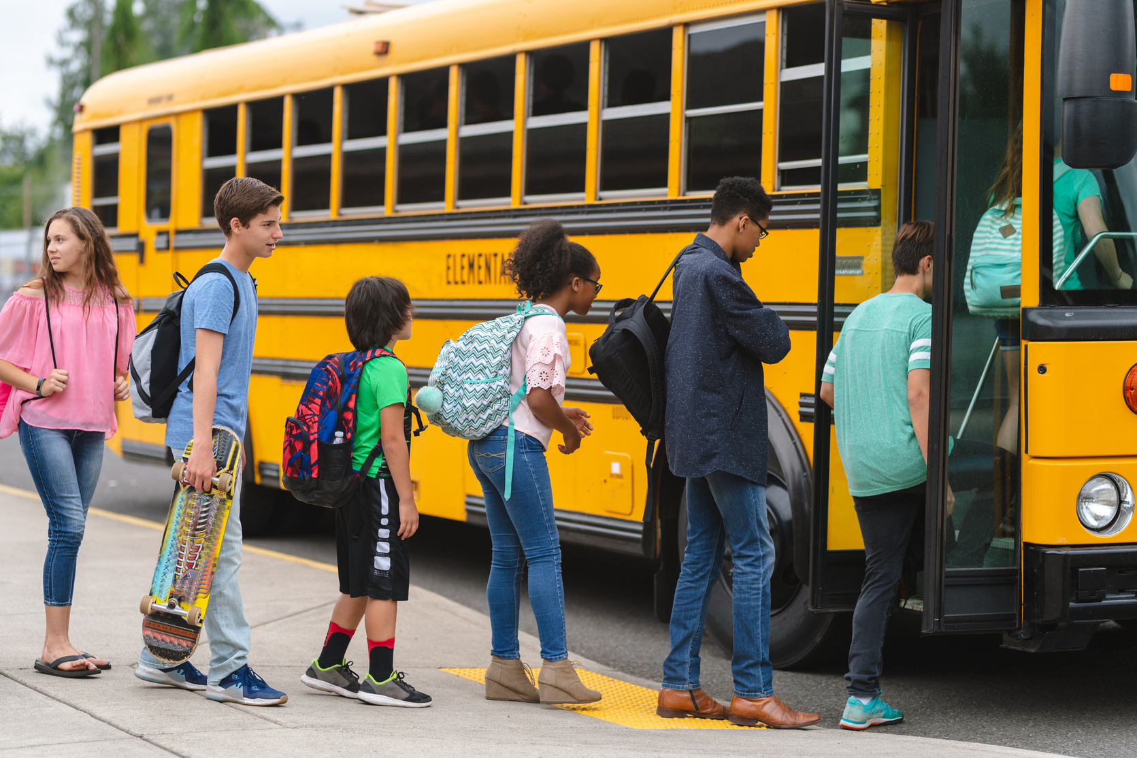
Site Specific Info
Schedule
Programs
Transportation
  Start 8:45-9:00 AM (late bell is 9:00)
  End 3:15
  Wednesday early release at 2:15
  Breakfast and lunch are for purchase
  Before-after school program:
  Sierra Kids through City of Reno
  You can find your child’s bus stop on the WCSD website.
Notes:
Your site will provide you with a calendar of the school year and the starting/ending time of the site.
Wednesday early release days are used for Teacher Professional Learning, and the minimum day schedule is also used during district wide Parent Conference week.
Some schools offer programs that other schools do not have, check with your site if you have any questions.
Good nutrition is important to learning, please be sure your child has a good breakfast, their brains need lots of fuel! –whether that be at school or at home (share with families if meals will be provided at school).
Please make sure to mark everything your child brings to school with his/her name.
If your child is not taking the bus, please be sure to be prompt in bringing them and picking them up.

Slide 9



Common Beliefs
•Children learn naturally
•Children know a lot before kindergarten
•All children can learn
•Children learn best when learning is kept whole, meaningful, interesting, and functional
•Children learn best when they are given choices
•Children learn best as a community of learners in a non-competitive environment
•Children learn best by talking and doing in a social context
Notes:
OPTIONAL SLIDE : Kindergarten teachers, in general, hold true to these important statements and their classroom will reflect these beliefs.

Slide 10

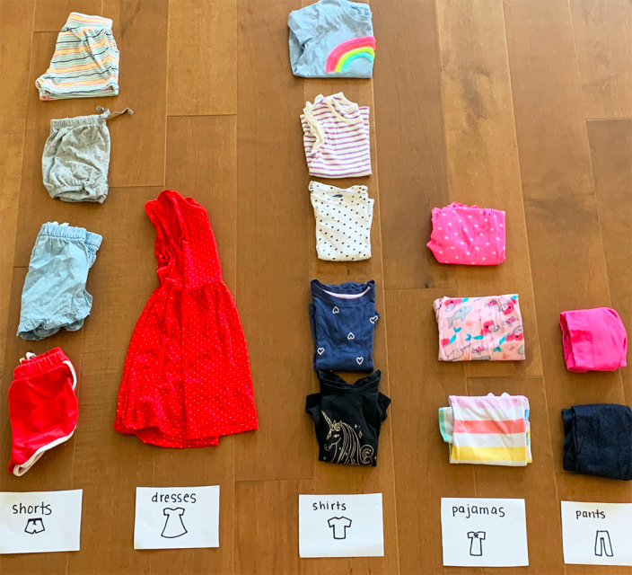
Play and Experience based learning
Notes:
This is an example of how young children learn and one idea on how to incorporate learning at home.
Show parents an example of experience base learning using this picture of a graph made using laundry. Give examples of questions parents could ask their child based on the graph.
1. How many shorts are there?
2. How many more pajamas are there than pants?
3. Which column has the least?
4. Which column has the most?
5. How many clothes do we have altogether?

Slide 11



•Science
•Math
•Art
•Reading
•Music
•Technology
•Social skills & problem solving
•Movement activities
•Fine motor activities
What will my child experience in Kindergarten?
Notes:
In Kindergarten, all students will participate in activities that address many different subject areas and domains of development… including….
If you have a specific school schedule that you follow, you may wish to share that with families.

Slide 12
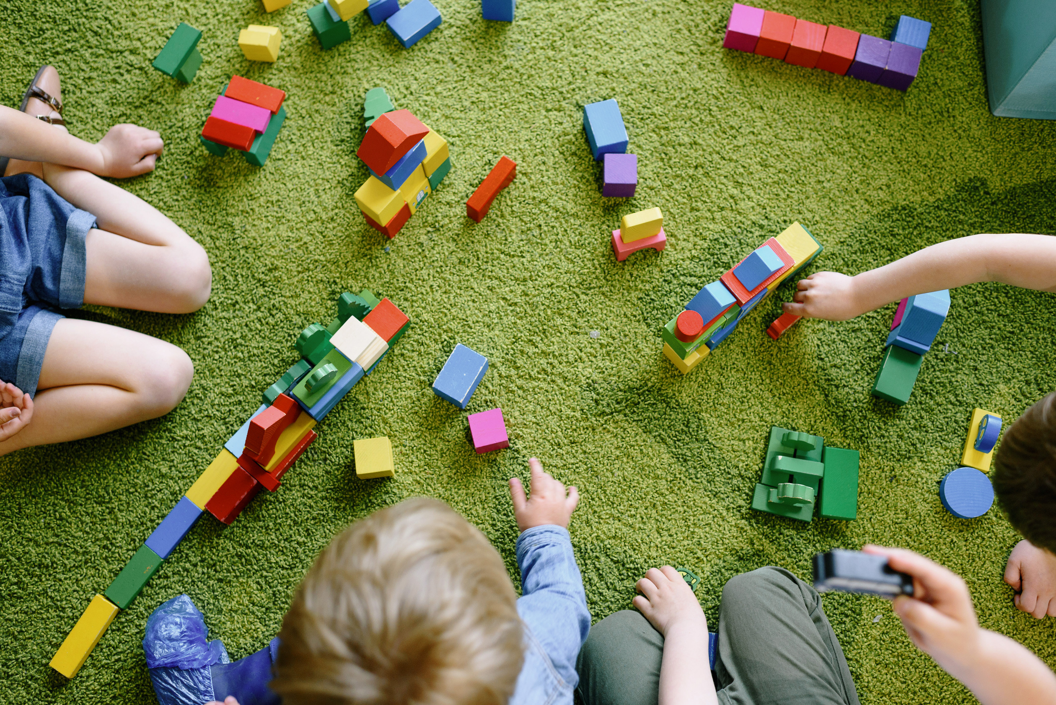
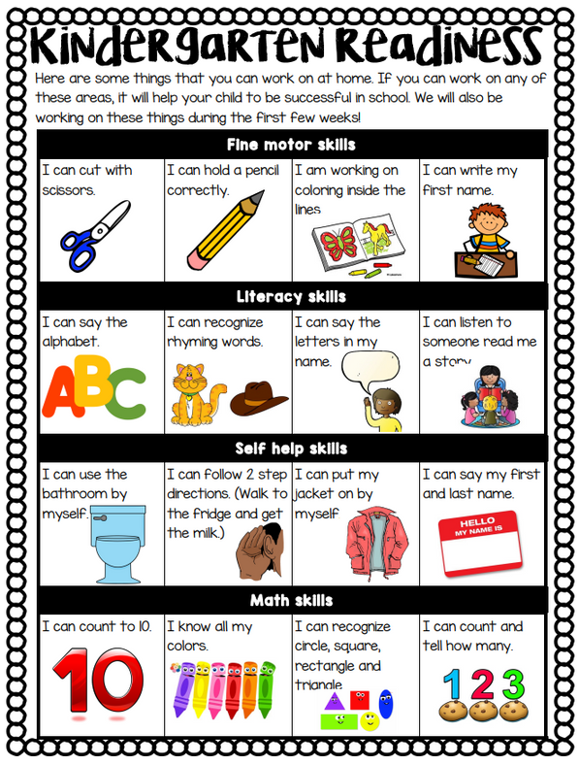
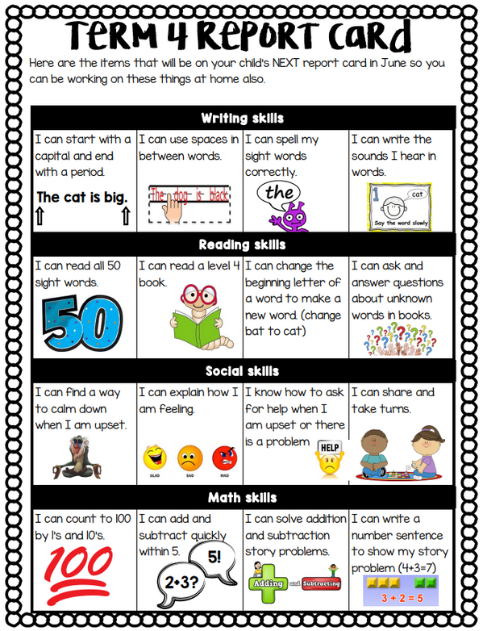
What will be expected?
Notes:
Have parents take out their document that shows kindergarten expectations throughout the year. Briefly go through expectations on each page.

Slide 13
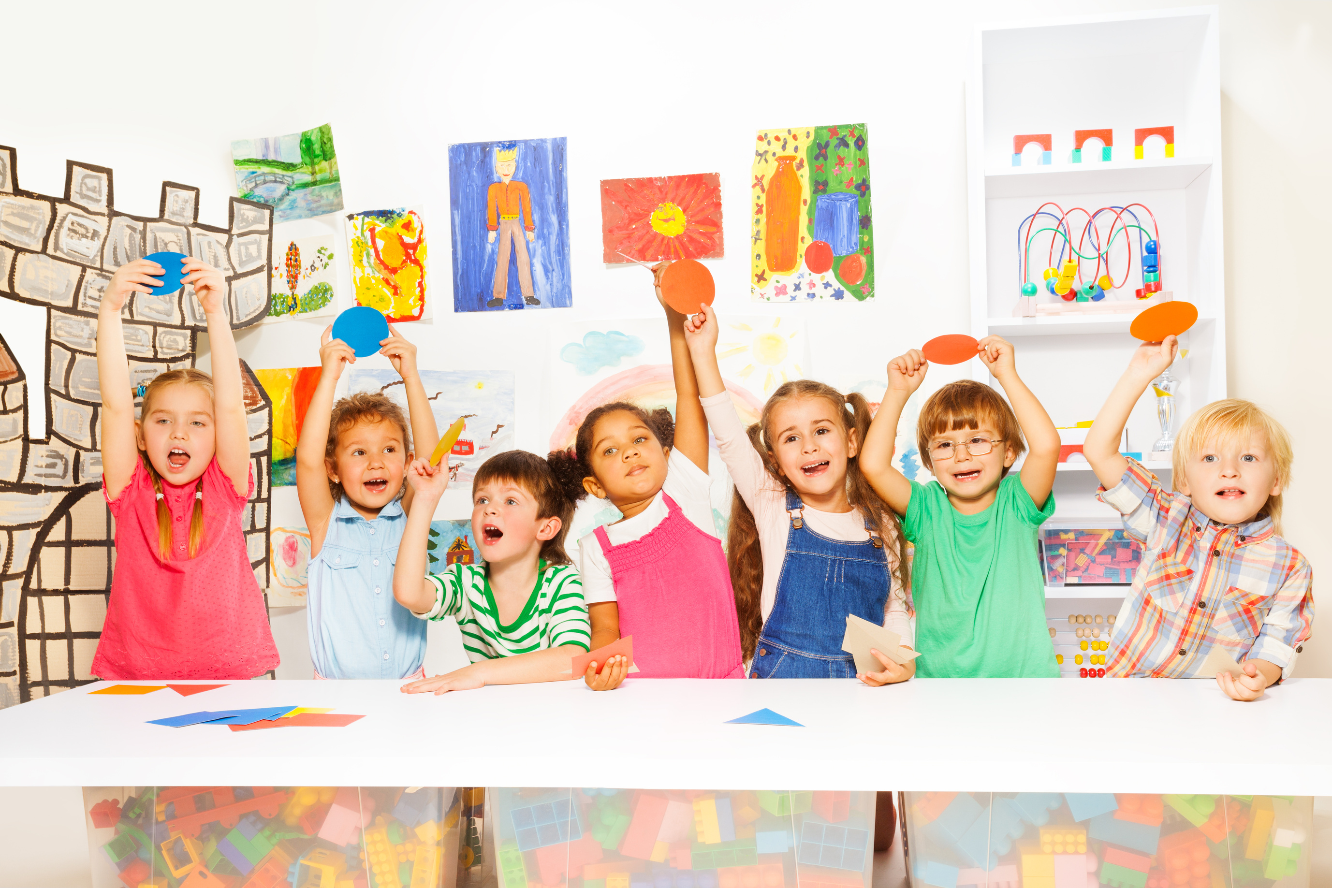
How can I help prepare my child emotionally?
•Talk about Kindergarten before the first day.
•Visit the classroom/school.
•Listen to concerns, answer questions.
•Be sure your child is well rested and fed.
•Help your child develop a sense of responsibility.
•Make Kindergarten a priority.
•Keep home routines consistent.
Notes:
-Talk with your child about kindergarten before the big day. Find out what she thinks kindergarten will be like. Be prepared to answer her questions: What will the kids be doing? How many kids will be there? What’s the teachers name? What will he carry in his backpack? Where will he eat lunch? Etc.
Visit the kindergarten classroom/school.
If possible, visit the classroom during the school term before she starts. Talk with the teacher and walk around inside the school. Visit the playground, the lunchroom, and the bathrooms. Seeing these places and people can help to ease some of the concerns your child might have. Taking your child through their routines before school starts can be helpful too. Practice walking to school or driving to school, getting up and getting ready, etc.
Listen to concerns, answer questions.
If your child is hesitant about starting kindergarten, let her know that you (or an older brother or sister or friend) felt the same way. Reassure her that she will get used to it very soon. Provide as much information as you can about your child’s questions to set their minds at ease. Have your child talk with others about their experiences with school.
Be sure your child is well rested and well fed.
Kindergarten is usually more tiring for children than preschool was. Your child will be better able to meet the demands of kindergarten if he is well rested and has had a good breakfast. When children start school, routines, regular bedtimes and mealtimes are more important than ever!
Help your child develop a sense of responsibility.
During the school years, you will want your child to begin taking responsibility for getting herself and her personal belongings to school on time. You will want her to
complete her schoolwork and classroom jobs. You will also want her to let you know when she brings home important notes from school. As much as possible, let your child
perform these important tasks for herself, starting in kindergarten. Doing so will help her feel capable and learn to be responsible.
Take kindergarten seriously.
Showing interest in your child’s kindergarten experience lets him know that school is valuable. Ask him who he played with, what books he read, and what activities he took
part in. Read the notes that come home from the teacher and school. Attend parent teacher meetings and as many other school events as your schedule will allow. Your
interest in your child’s kindergarten experience sends an important message.
Keep home calm and consistent.
With all the adjustments to school, it is important that home remain the constant. Try to stick to the same routines. Don’t schedule your child for many other activities outside of school during the start of the school year while your child is adjusting. Provide plenty of down time at home. Make yourself available to play and talk with your child about their day and experiences.

Slide 14
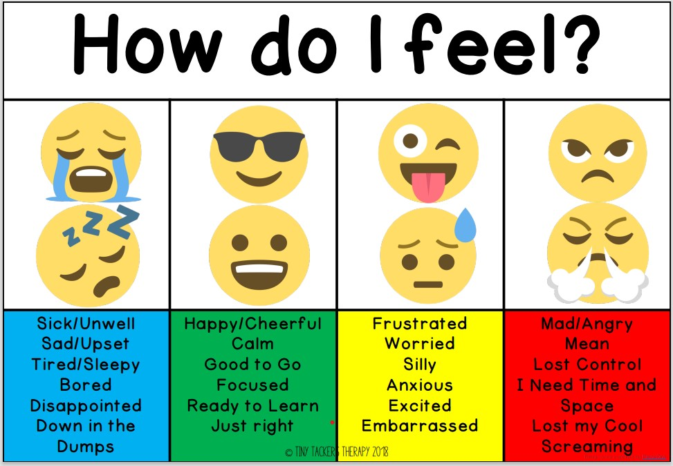
Identifying emotions
Notes:
The following activities are optional. Pick and choose the activities that best meet your needs.

Slide 15
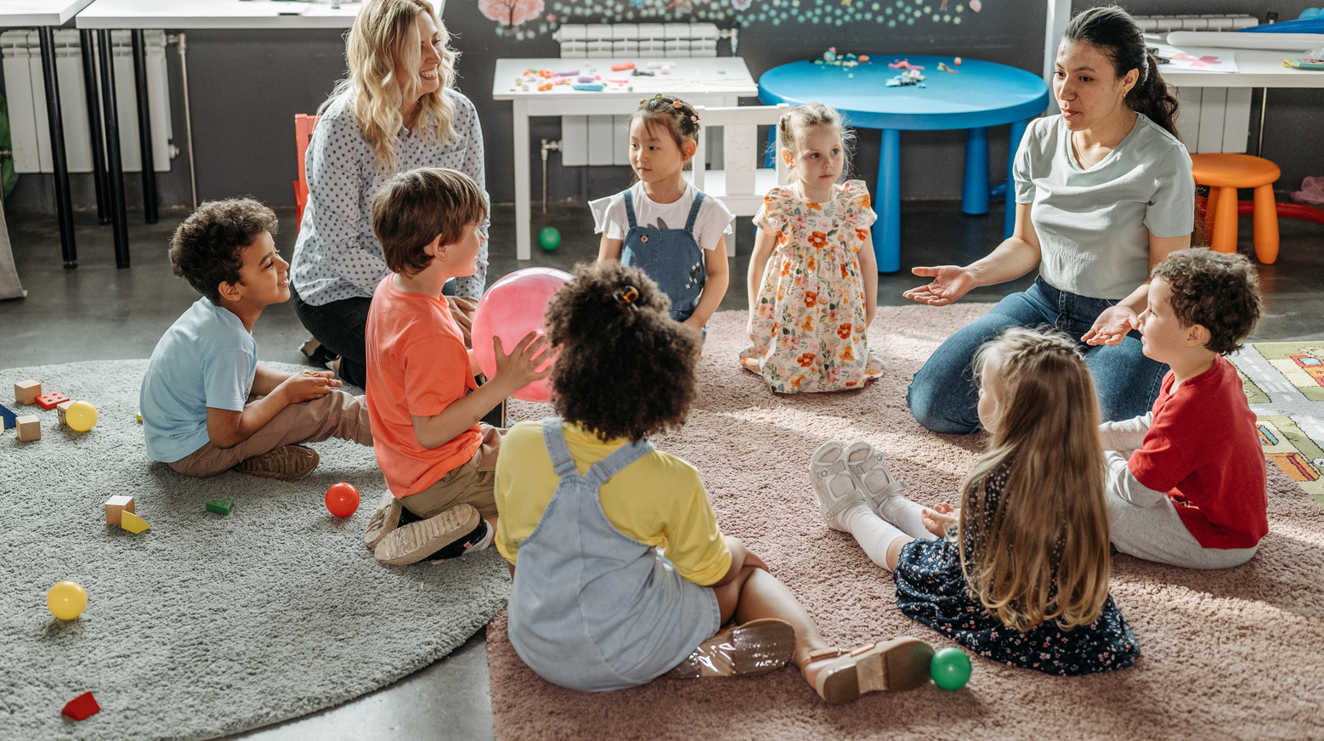



Support play and experience-based learning (see activity cards)
Give your child opportunities to draw and/or write daily
What can I do with my child before Kindergarten?
Read Daily with your child!
Let's Learn About & Practice Each Now!
Notes:
Reading books is a great way to build vocabulary, and vocabulary is the foundation of all learning. After all, The single most significant factor influencing a child’s early educational success is an introduction to books and being read to at home prior to beginning school. (this fact comes from this research if asked). *National Commission on Reading, 1985
Provide daily opportunities for reading picture books to and with your child
Consider making your child a journal and letting them draw/”write” daily in it. On the page you can write down whatever they say about their work or story (take dictation).
The best way children this age learn is through play and experience with a supportive adult.

Slide 16


Read Aloud Strategies
  Talk about it before you read it to build anticipation
  Use the picture or title to ask what they think the story might be about or what might happen in the book (predict)
  Relate the story to the child’s life
  Talk about the colors, shapes and number of things in the pictures.
  Before you finish the book, have them guess what the ending might be
  After finished ask which part they liked best
Notes:
Model how to do a read aloud.
Tell families- The idea of this is that you are modeling how to make story time more interactive and engaging. This will help them learn even more from your reading time. It will be their turn to read a book with their child and practice next. And they get to keep the book to read over the summer!
***If available, give each family a Read Aloud book to borrow. Have families read with their child using some of the strategies you modeled/strategies from the video.
Reading Books Together – Here is an optional video to share some of these strategies in action

Slide 17
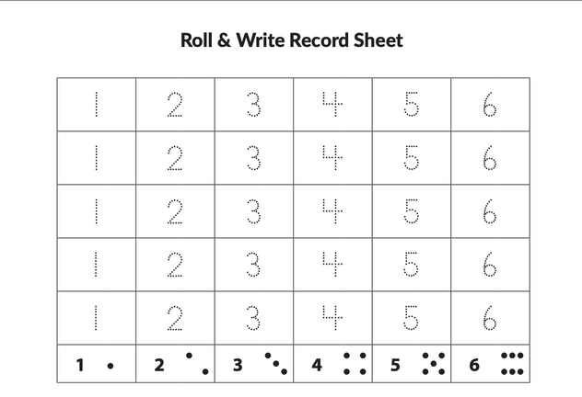

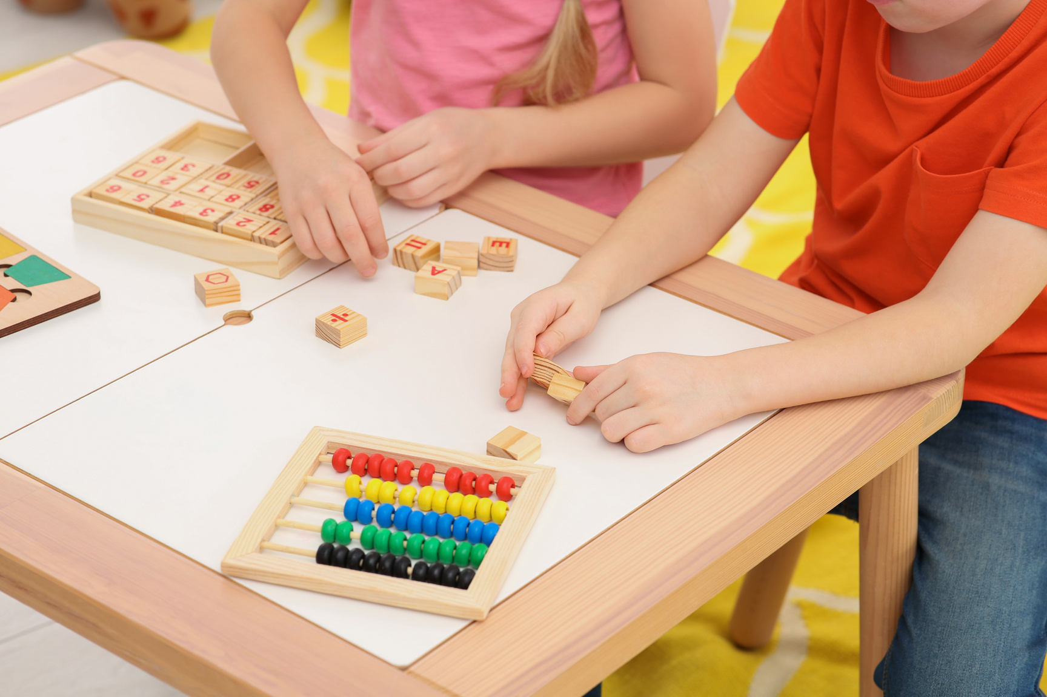
  Match the dot card to the numeral card.
  Take turns identifying the numbers and doing that many movements.
  Flip the cards upside-down and play memory.
  Play Go Fish with your cards.
  Play Roll & Write (see packet for directions)
Counting and Numbers Activities
Notes:
Choose any of the activities mentioned in the slide to engage in with families. Please see email attachment for record sheet and printed directions.
Roll & Write
Objective: Roll the dice, count the dots, and write the number to fill up 3 or more columns. Which number will win?
Roll the die or pull a piece of paper from the cup. Show the results on your record sheet by writing the number. » If pulling pieces of paper, be sure to return the piece of paper to the cup after each turn.
Working from the bottom to the top of the graph, continue to roll (or pull slips of paper) and write the number until two or three columns are filled. » Some children like to make a smiley face or star by the first number that fills its column to indicate the “winner.” » Some children like to keep going until all of the columns are filled. » If you roll or pull a number that has already been filled, you can take another turn or you could make tally marks next to that number to show each additional toss.
Invite your child to share the results while working. See the Tips for Families for suggested questions to ask.
Materials Needed:
Roll and Write Record Sheet
1 Die (dotted 1-6) – available in Bridges materials
Pencil, marker, crayon, or colored pencil
If families finish, encourage them to play again. Children learn numbers by repeatedly seeing them.

Slide 18

Draw/Write Daily
Make and Take
  Work with your child to make and decorate a journal.
  If time allows, let your child start writing or drawing in their journal.
Notes:
By having children draw and write daily they are supporting writing development, helping their child with fine motor skills, and building confidence.
Families will now work with their child to use the materials at their tables to make and decorate a journal
(construction paper should be the front and back cover, plain white paper should be the pages- stapled together. They can decorate the front)
Encourage families to:
-talk with their child about what they drew
-write the date on it
-write down what they say about it (take dictation)
Tell families that it is important that their child see them write as well- even if it is just a weekly grocery list. THEY are their models!
TEACHER TIP- if you want your child to start tracing letters, try writing a letter (or their name) in yellow marker and the child can trace the letter by writing directly on top of the yellow marker. Model this as needed.
Once it is complete, the student can draw/write on their first page as the families fill out the evaluations.
Materials Needed:
Construction paper
Crayons, markers, pencils
Staplers

Slide 19

School Tours
School tours will be provided during JWood Raw's Kindergarten Round-up on April 8th from
3:30-5:00 PM and during your registration appointment.
Notes:
After the presentation, invite families to take a guided tour of your building. You may wish to do this whole group or do rotations of small groups. Consider using the “optional activities” on slides 17-19 as stations, and the school tour can be an additional station to attend.

Slide 20
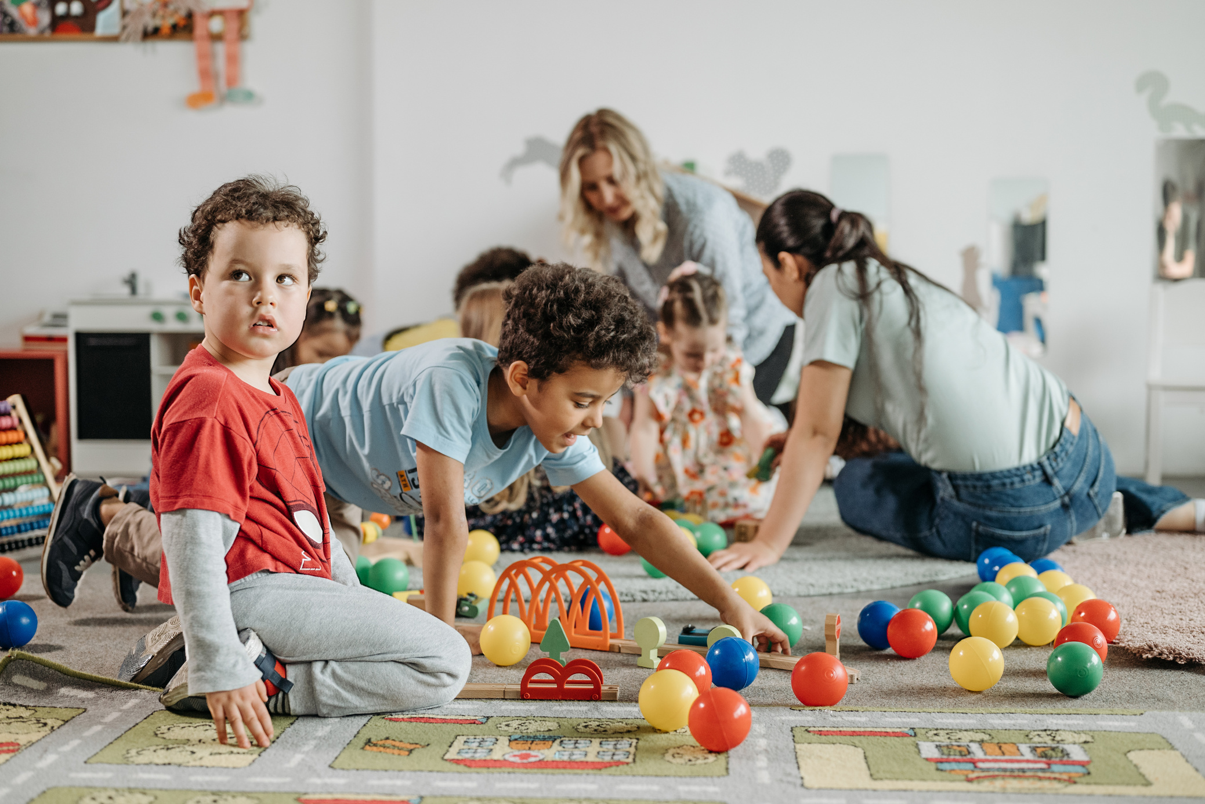
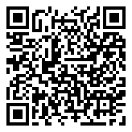

Registration
Now Open
1. Complete online registration:
www.washoeschools.net/enroll
2. Visit your child’s school and bring:
  original birth certificate
  immunization records
  proof of residence (utility bill)
Notes:
Registration is now open for kindergarten. To register please go online to Infinite Campus (link is on WCSD website) Once online registration in complete, bring the following items to your child’s zoned school.

